Slide 1
People Centric Sensing for Citizens
Urban sensing – subsection: citizens
Masoud Ghandehari

Slide 2
Background
Internet → real-time information sharing in Cyberspace
Mobile internet → continually connection between citizens and Cyberspace
Internet of things → connection of Cyber-Physical
Social networks → features of human social relationship shown in Cyberspace

Slide 3
Smart Phone: a bridge of citizens sensing
Mobile phone is a bridge between citizens and Cyber- physical world in smart cities.

Slide 4
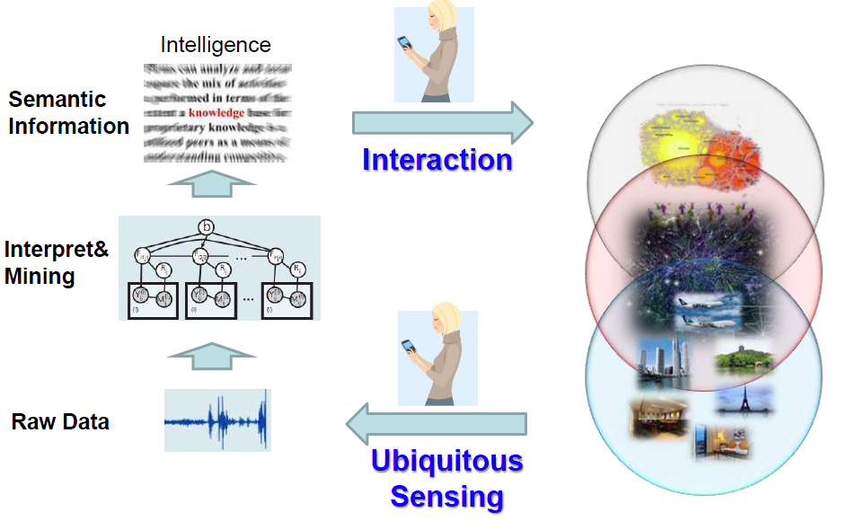
Computation Paradigm

Slide 5
Outline
Sensors
Sensing What?
Trends

Slide 6
1. sensors
1.1 Sensors build-in mobile phone
1.2 External sensors connoted to mobile phone

Slide 7
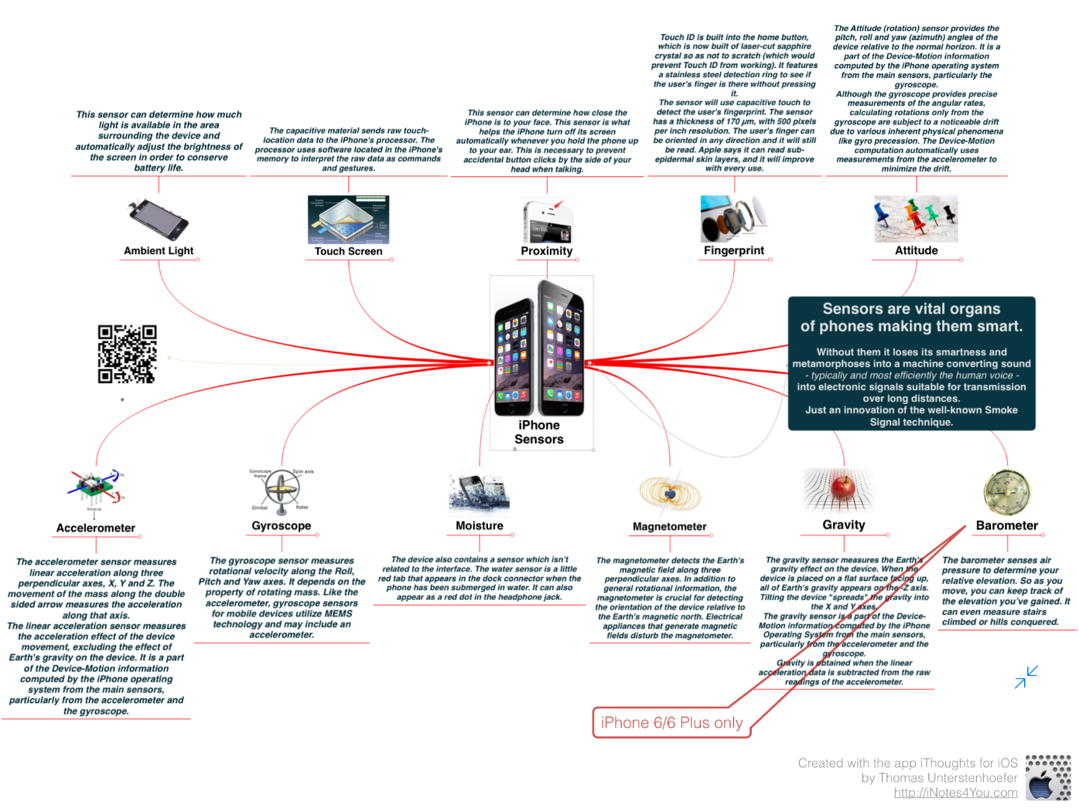
1.1 Smart phone build-in sensors

Slide 8
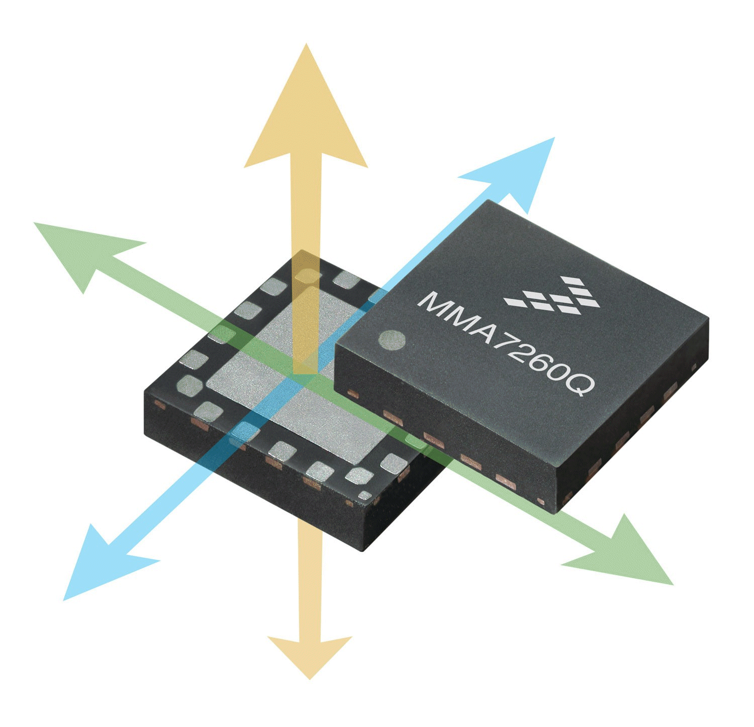
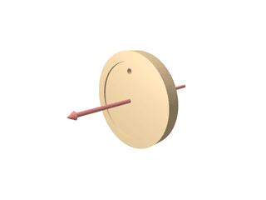
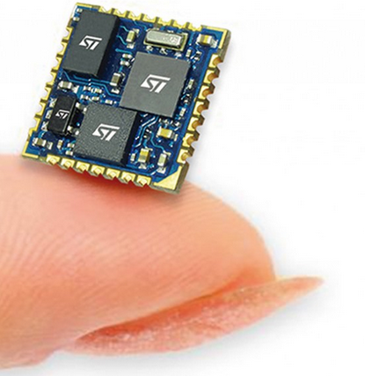
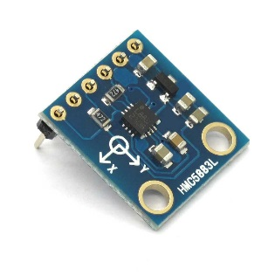
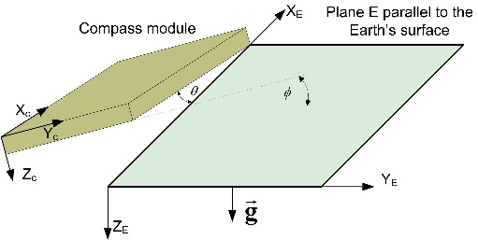
1.1 Build-in sensors
Accelerator
Data of accelerator in x, y, z axis
Including accelerator of earth, unit is m/s2
Gyroscope
Data of angular velocity in x, y, z axis
Unit is radians/second
Electronic compass
Data of magnetic in x, y, z axis
Unite is micro Tesla, uT

Slide 9
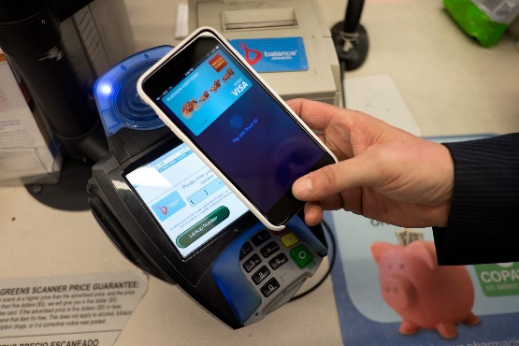
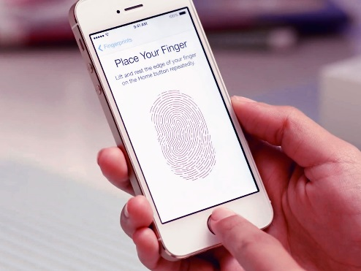
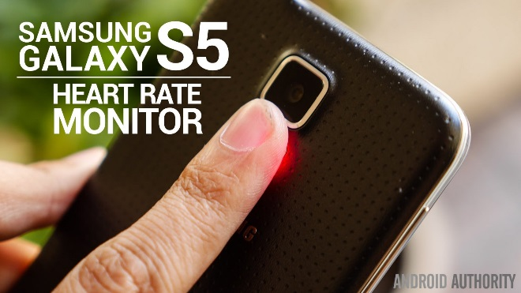
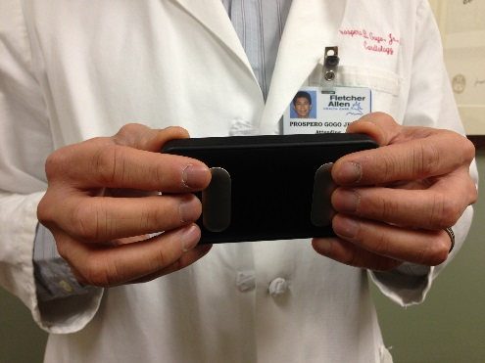
1.1 Build-in sensors
Light sensor
Temperature sensor
Proximity sensor
Wi-Fi
Bluetooth
GPS/AGPS
NFC
Micrometer/Camera
FM
Fingerprint
Heart rate / ECG
NFC
Finger print sensor
Heart Rate sensor
ECG sensor

Slide 10
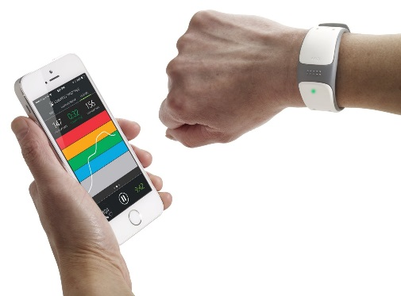
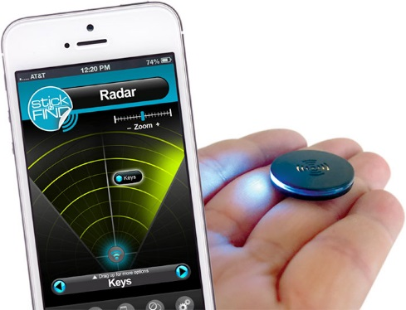
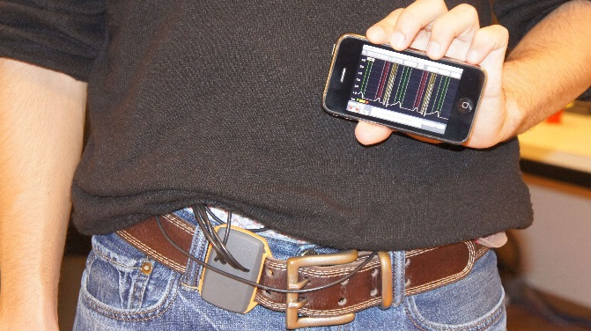
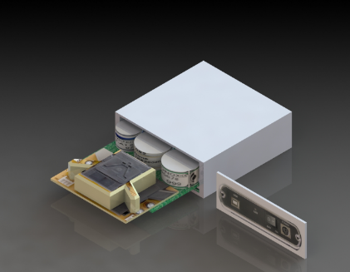
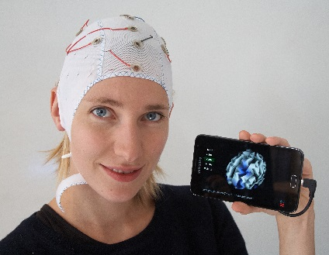
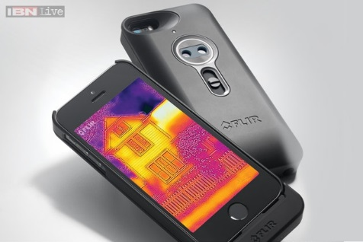
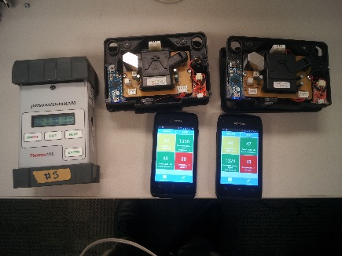
1.2 External sensors
Sleep sensor
EEG Headset
Air pressure sensor
Radar/ heat camera
Chemical gas sensors(CO, NO2, O3)
PM sensors
Heart rete sensors
ECG sensors
Wireless Heart Rate Sensor
Radar Sensor
ECG: http://esl.epfl.ch/page-46016-en.html
Wireless Gas and PM sensors
EEG: http://www.bhutanbrain.com/
Heat Camera Sensor

Slide 11
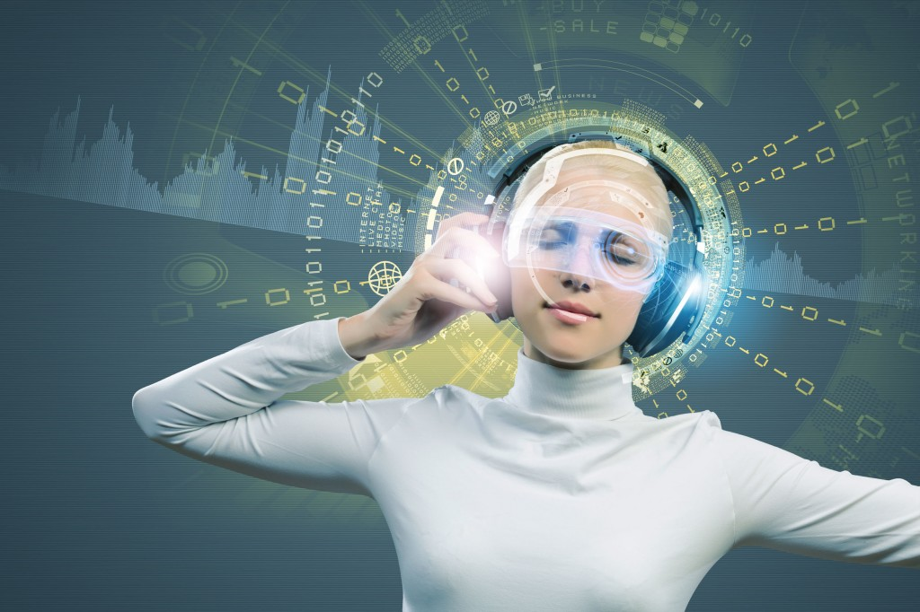
Sensing What?
Who you are?
Where you are?
What you are?
What you see?
What you listen?
What you act?
What you feel?
What you think?

Slide 12
2. Citizen sensing
2.1 Sensing ID
2.2 Sensing Location
2.3 Sensing Gesture
2.4 Sensing Emotion
2.5 Sensing Activity
2.6 Sensing Co-presence
2.7 Sensing Orientation
2.8 Sensing Thinking

Slide 13
2.1 Sensing ID
Perceive and Identify an object/thing
Sensors: QR codes, NFC, Face realization, Voice, Bluetooth ID, Accelerator

Slide 14
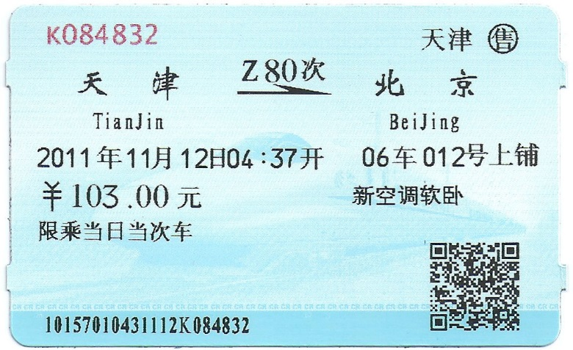
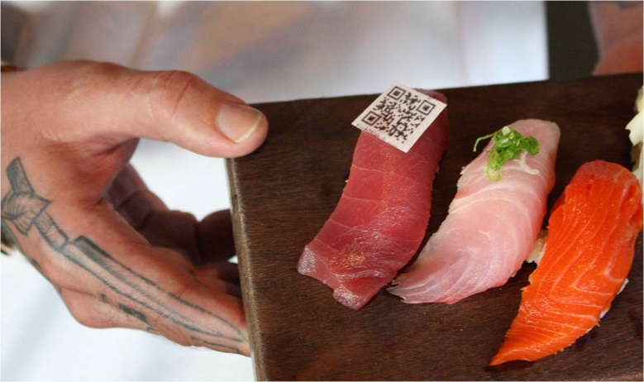
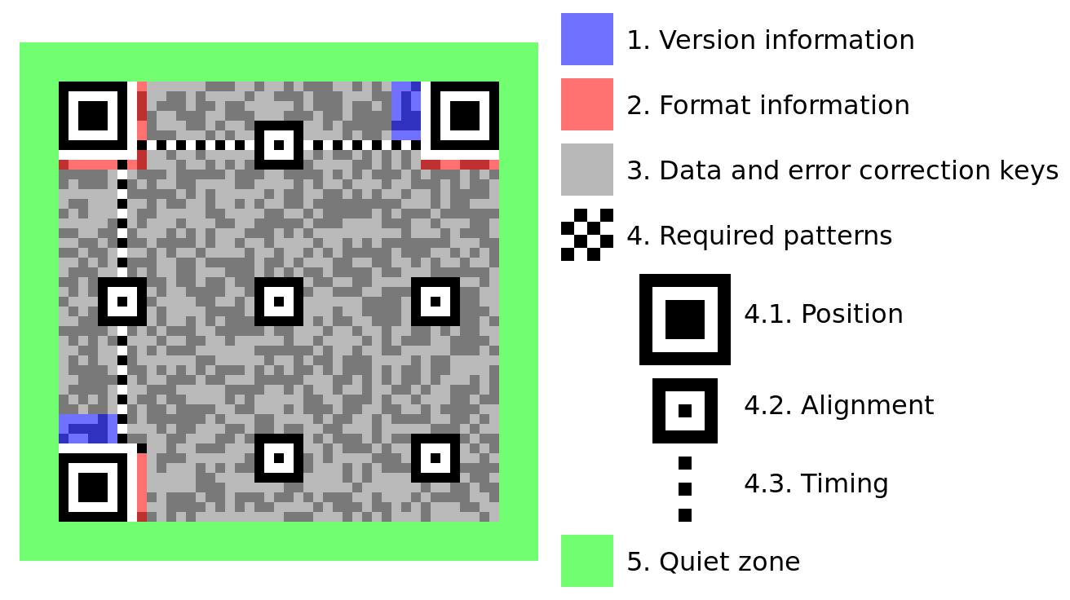
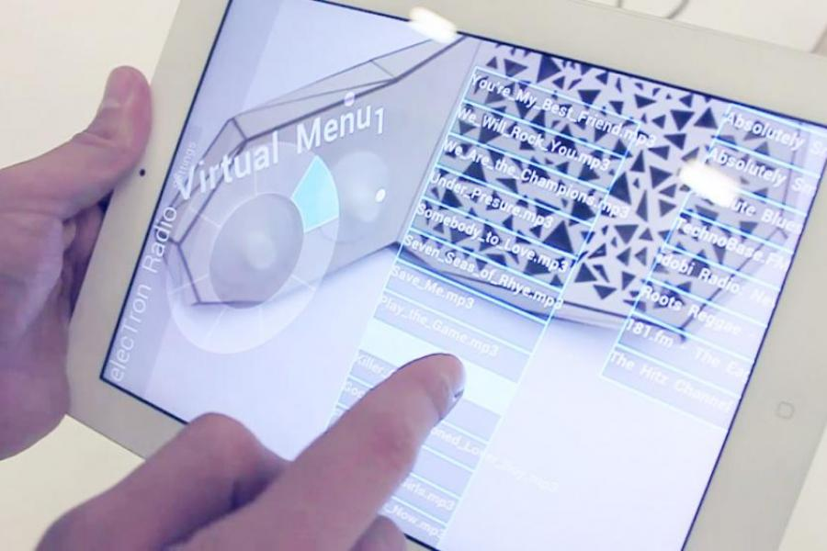
2.1 Sensing ID- QRcode
QRcode
Easily download APP of restaurant
Free Pattern identify and AR application:
https://vimeo.com/60138572

Slide 15
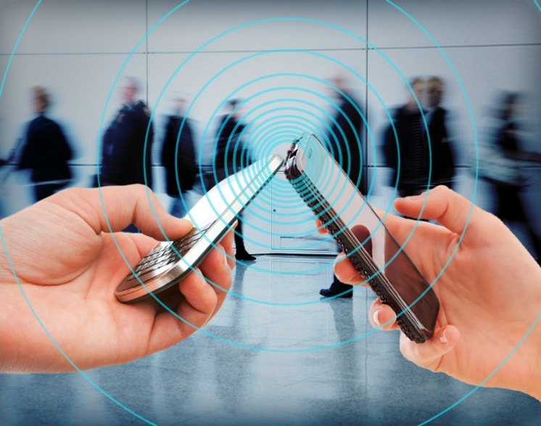
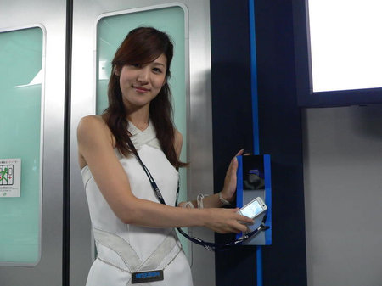
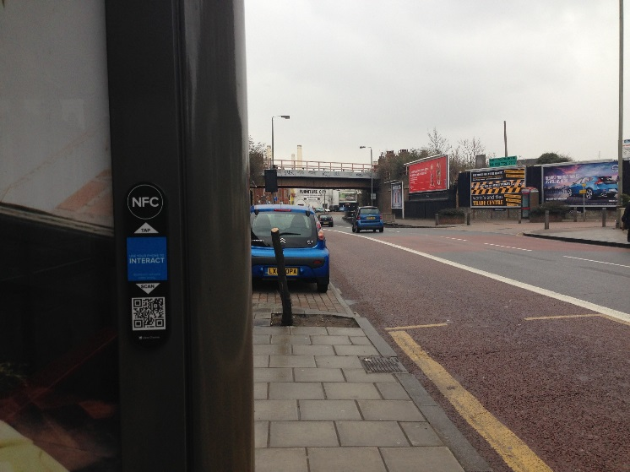
2.1 Sensing ID - NFC
Application Scenarios
Identify and access authority
Exchange contact
Social networking
Exchange contact
Identify and access authority
An NFC bus shelter in a deserted London street. Do they seriously think that anyone will tap on this?

Slide 16
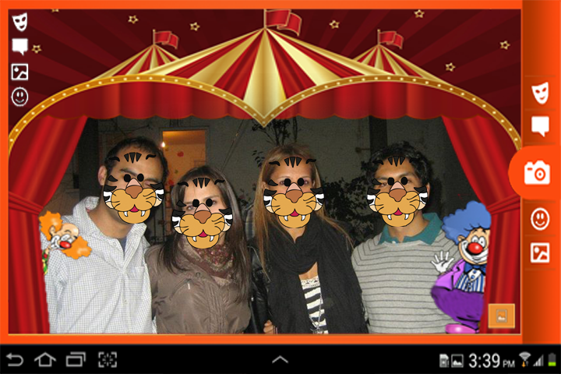
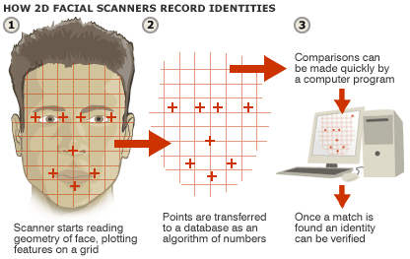
2.1 Sensing ID – Face/camera
AR Faces on google store

Slide 17
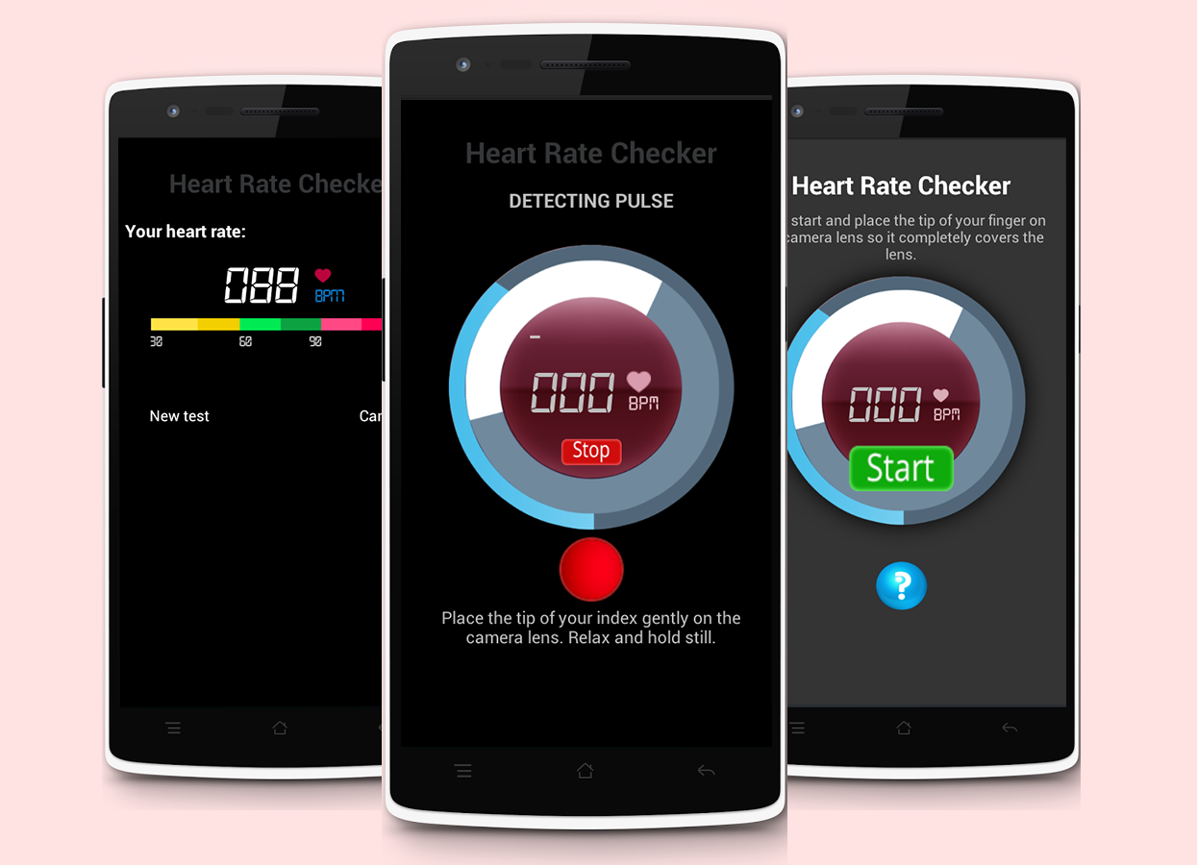
Heart Rate Checker in google store, hold your finger on the lens of the camera steadily and gently made for the entire measurement process. Utilize Camera to monitor heart rate.

Slide 18
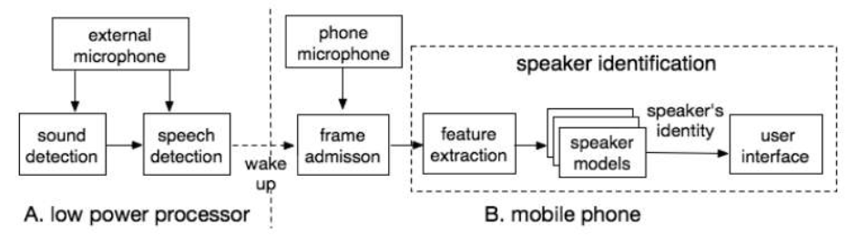
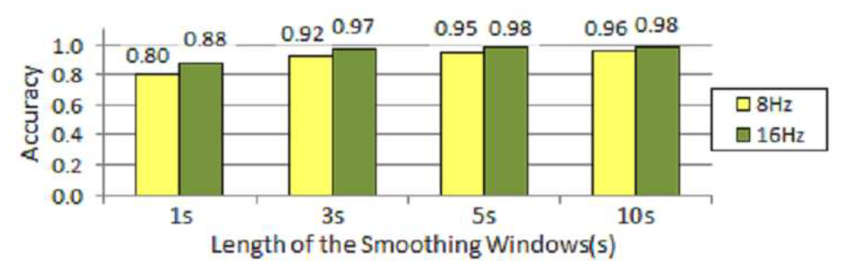
2.1 Sensing ID - Voice
SpeakerSence
Architecture of SpeakerSence (H.Lu et al, Pervasive 2011)

Slide 19
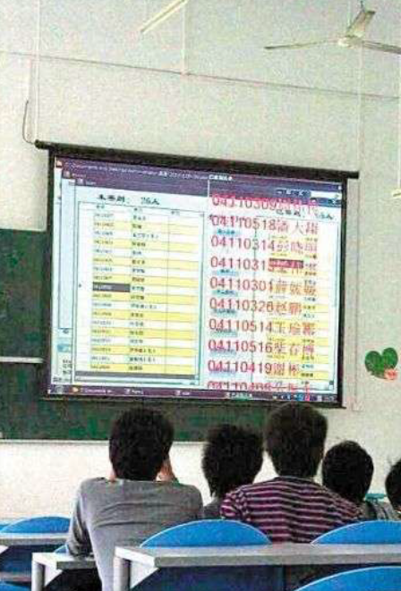
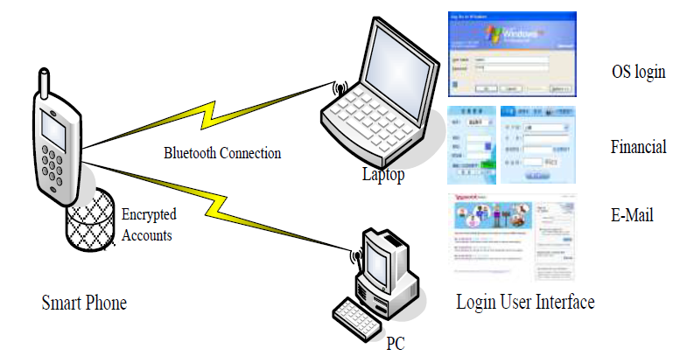
2.1 Sensing ID - Bluetooth
ASK processing of building connection
ID of devices
SmartID with Bluetooth-enabled Phone
Count/identify of human
Automaticly signature via bluetooth of students’ mobilephones at a classroom in 2010
SmartID (Weili Han et al, Information 2012)

Slide 20
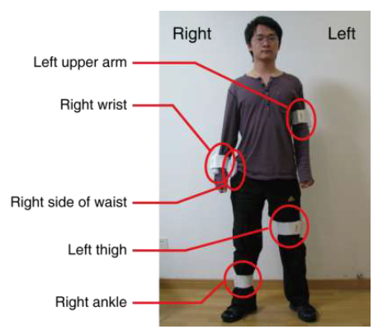
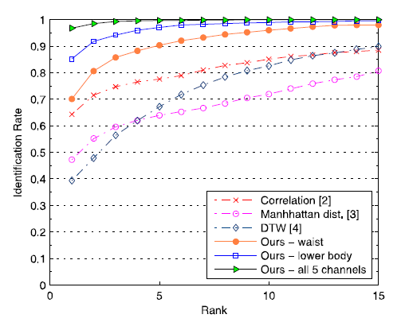
2.1 Sensing ID - Accelerometer
GaitPrint
Accelerometer-based Gait Recongnition
Sensors attached: 5 body parts
Performance on a dataset w/30 sujbects: 96.7%

Slide 21
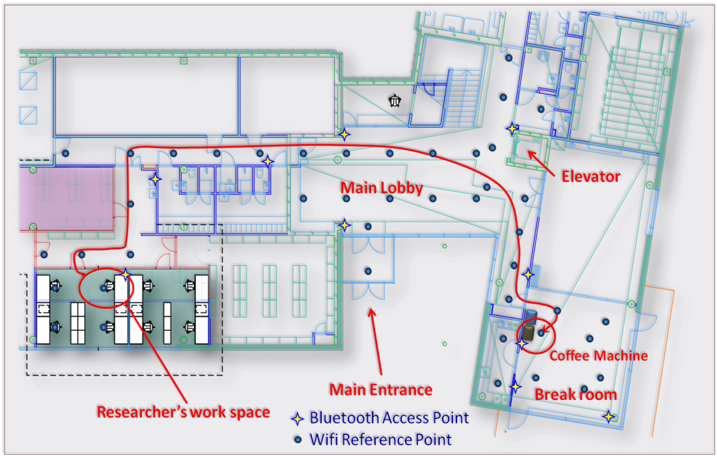
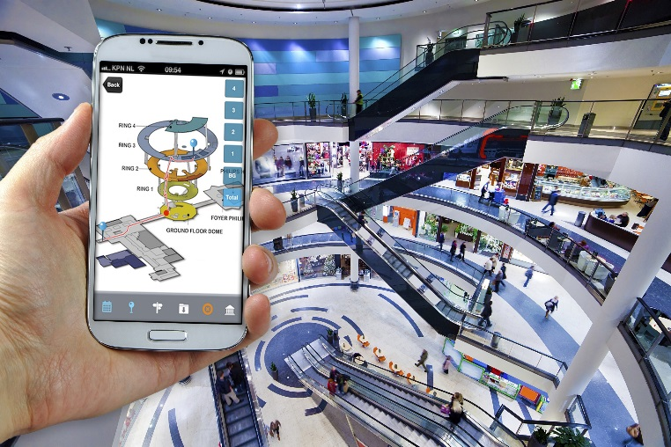
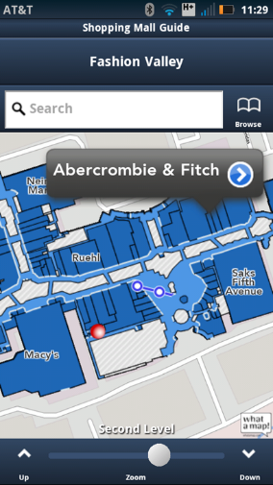
2.2 Sensing Location - Wi-Fi
Indoor location
Physical location: 45 N, 145 W
Description location: at kitchen, nearby mailbox
Sensors
Wi-Fi, GPS, NFC, Bluetooth etc.
CSR indoor location
http://www.fgi.fi/fgi/themes/indoor-navigation

Slide 22
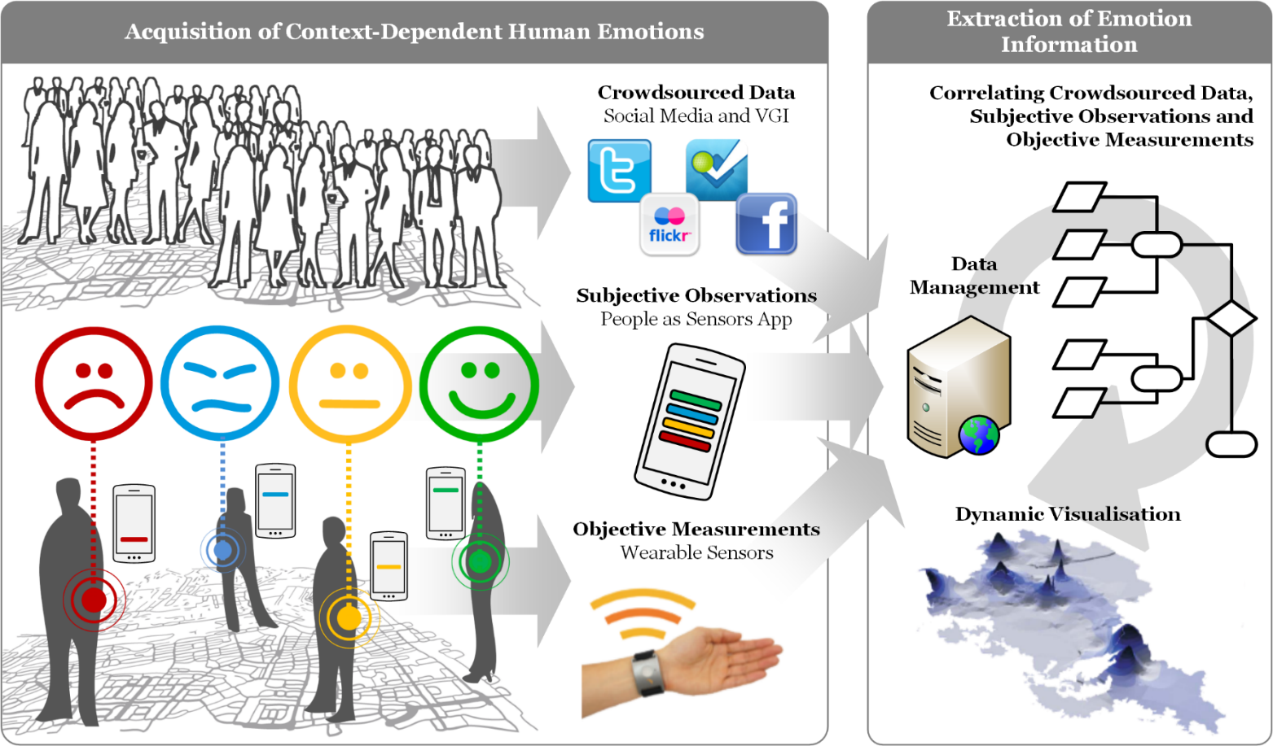
2.4 Sensing Emotion
Urban Emotion

Slide 23
2.5 Sensing Activity
Perceive citizens behavior
Device not present
Resting (sleeping, sitting)
Walking
Running / Jogging
Bicycle riding
Car driving
Being activity (gardening, cleaning etc.)
Sensors
Accelerator
Gyroscope

Slide 24
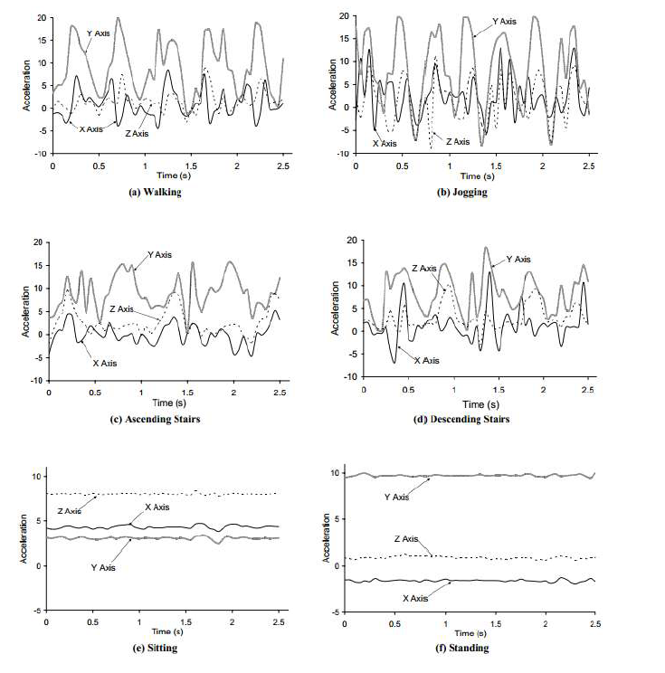

Slide 25
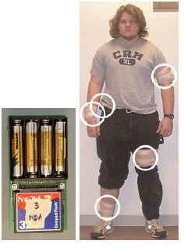
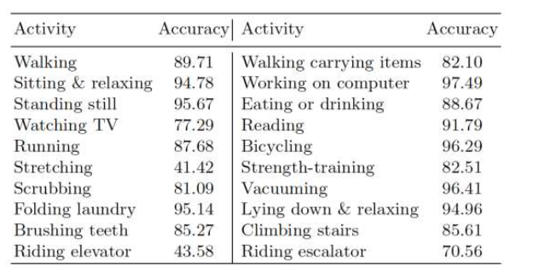
2.5 Sensing activity
Activity recognition from user-annotated acceleration data
MIT Media Lab
Bao et al, Pervasive 2004

Slide 26
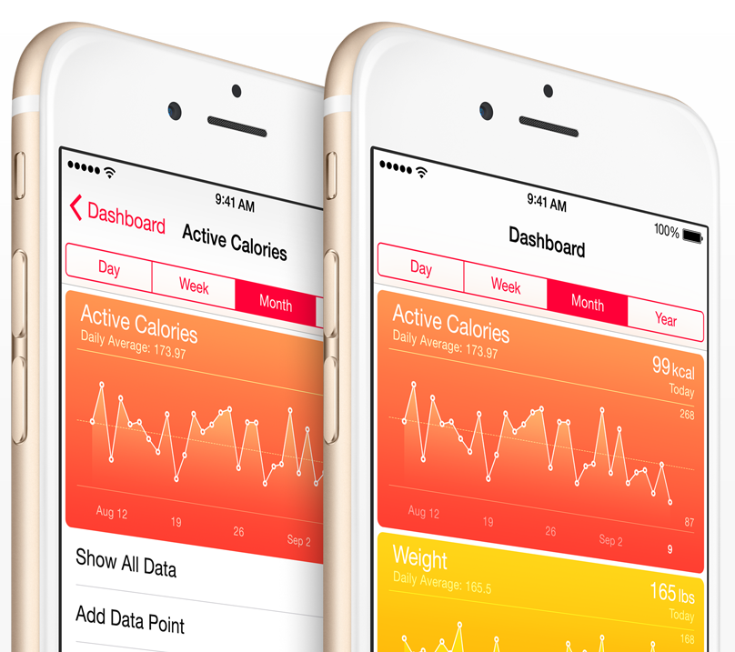
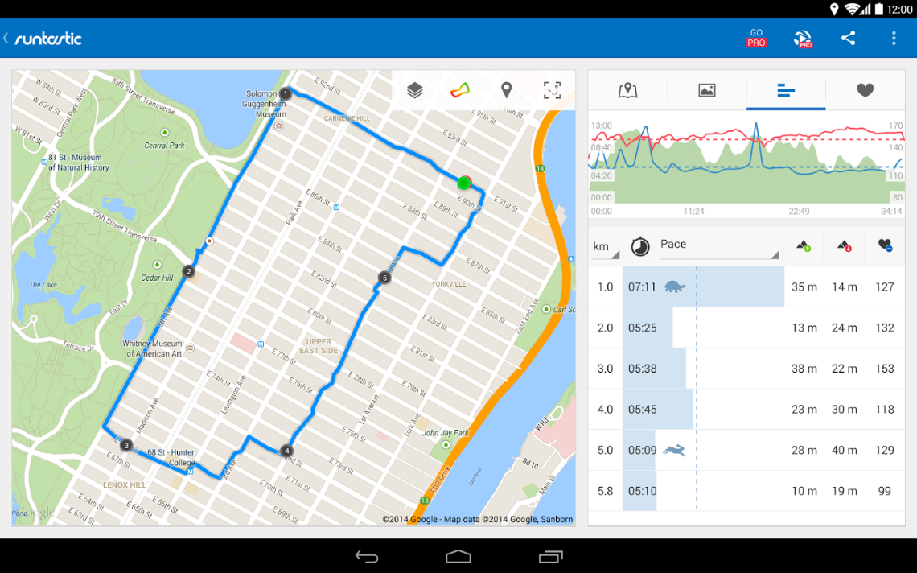
2.5 Sensing Activity
APP
Runtastic Running & Fitness on google store
health and ﬁtness app on Iphone6

Slide 27
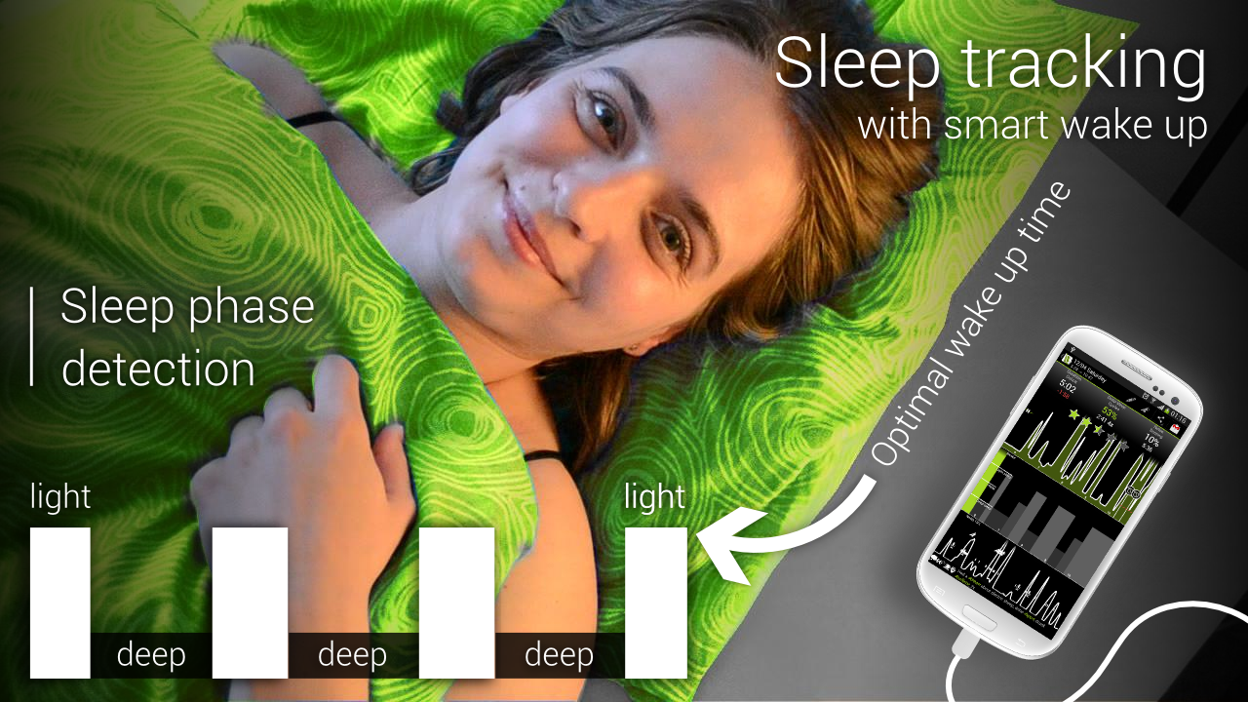
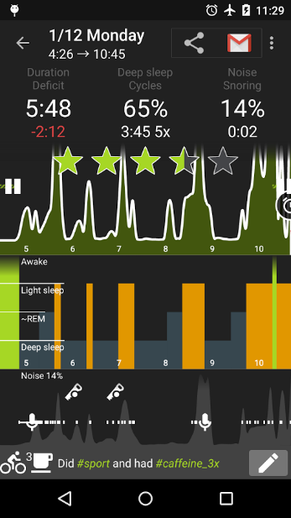
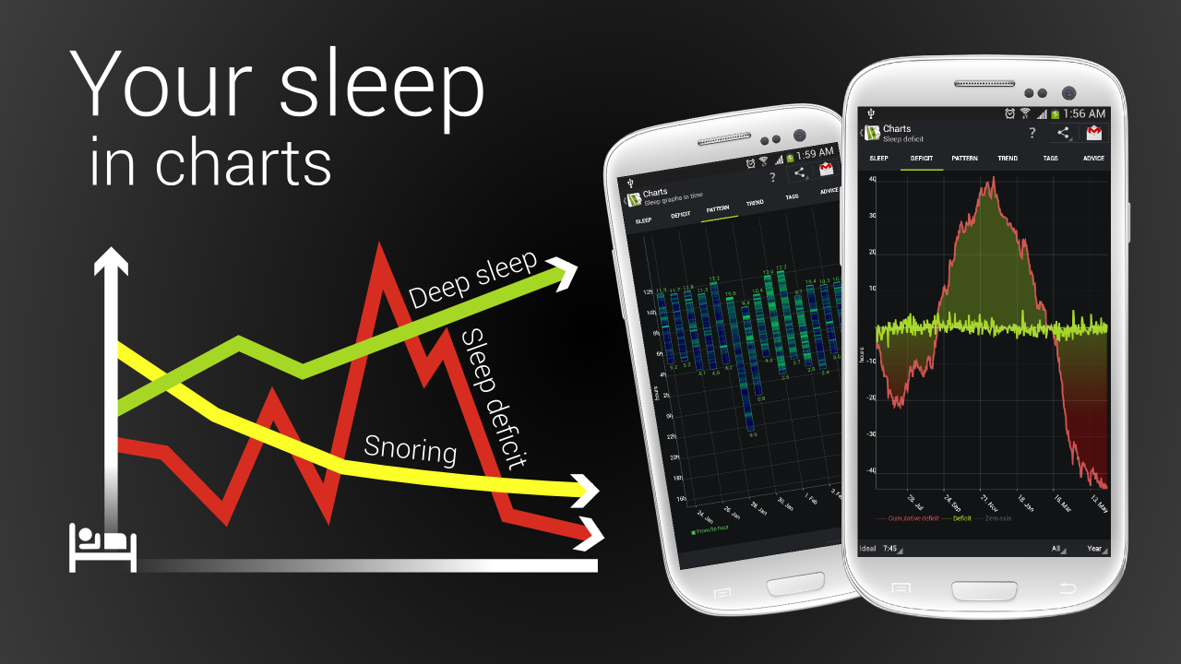
Sleep as Android in google store, utilize accelerator to monitor sleep status

Slide 28
2.6 Sensing Co-presence
Crowd behavior
Meeting
Party or parade
Social networking
Sensors
Bluetooth, GPS/ WIFi, Camera

Slide 29
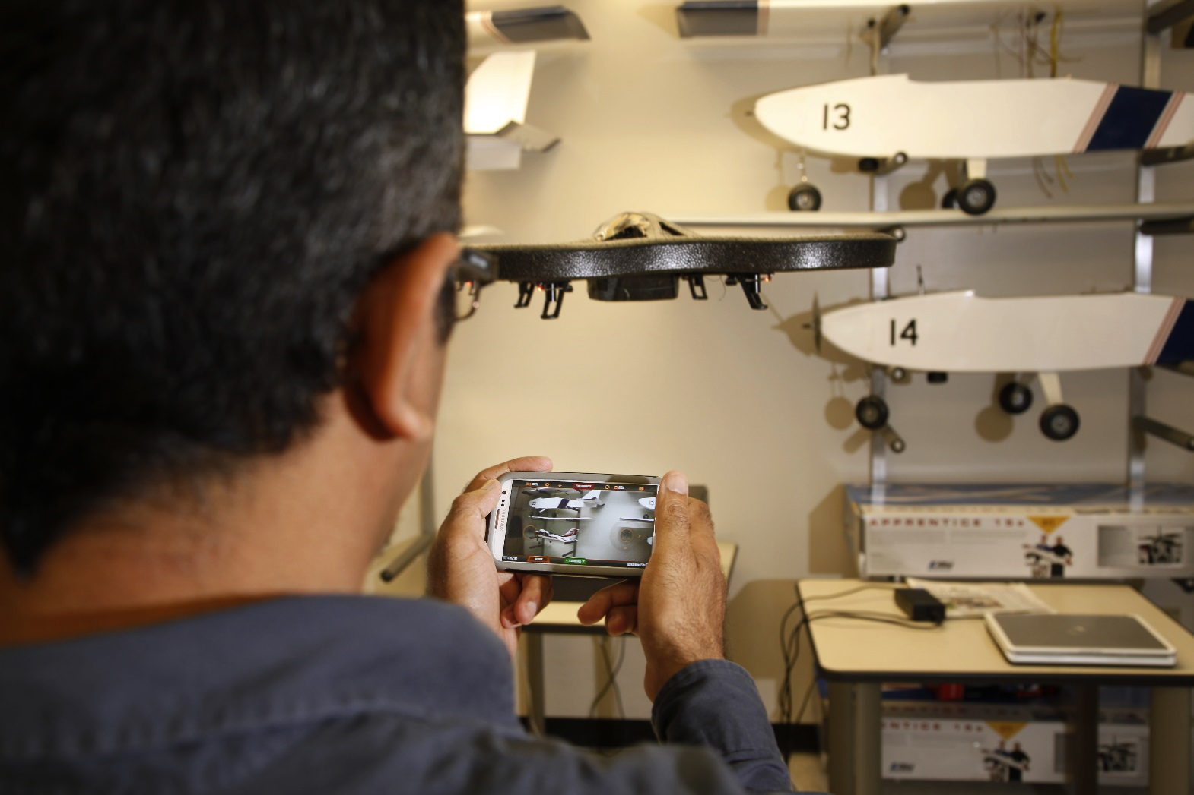
2.7 Sensing Orientation
control drone via accelerator of mobile phone

Slide 30
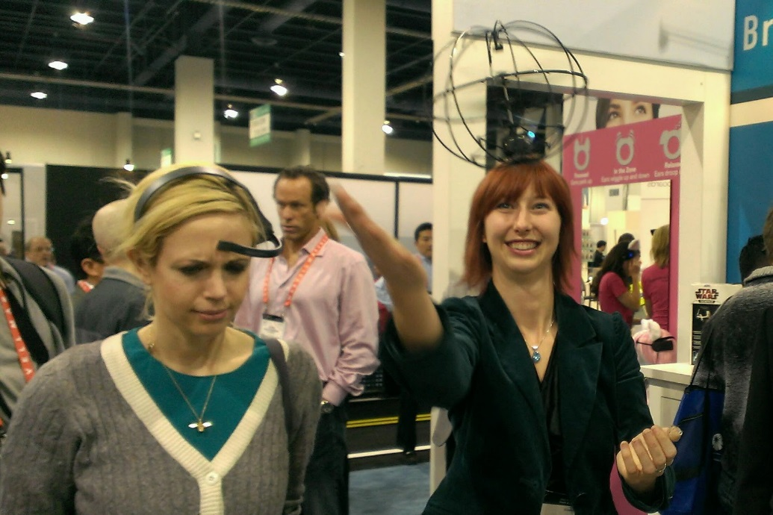
2.8 Sensing Thinking
EEG control drone / wheelchair [video]
Monitor activity of brain cells when human thinking, and detect the vary voltage of Field Potentials to identify a idea.
The girl on the left just launched the toy helicopter using her brain waves. She's wearing a version of the $99.

Slide 31
3. Trends
3.1 Participate Sensing
Citizens report, analysis, share information of their surrounding environment.
3.2 Wellbeing Sensing
BeWell, mobile healthcare application
Health Estimate, Sleep time, Sports activity, Social activity

Slide 32
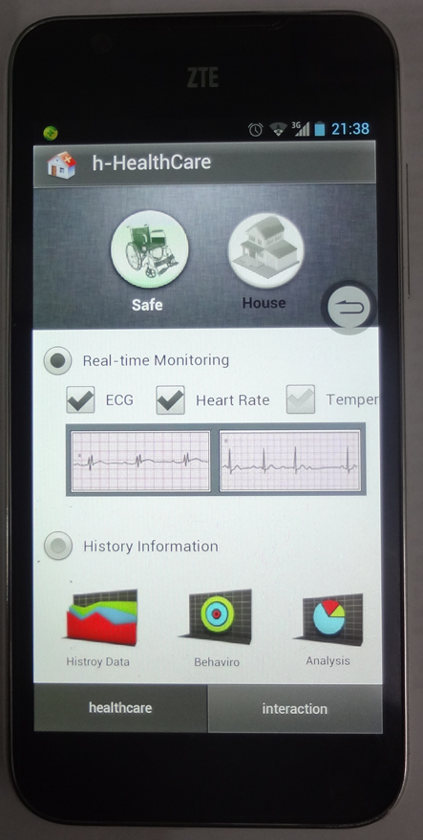


(a) (b) (c)
screenshot of smart phone used by the wheelchair user, (a) shows that the smart phone perceives the vital physiology parameter of wheelchair user, (b) shows that the smart phone controls the local shared household equipment via remote online resource, (c) shows wheelchair interacts with RFID lock via WeChat, a IM of online social network.

